Slide 1

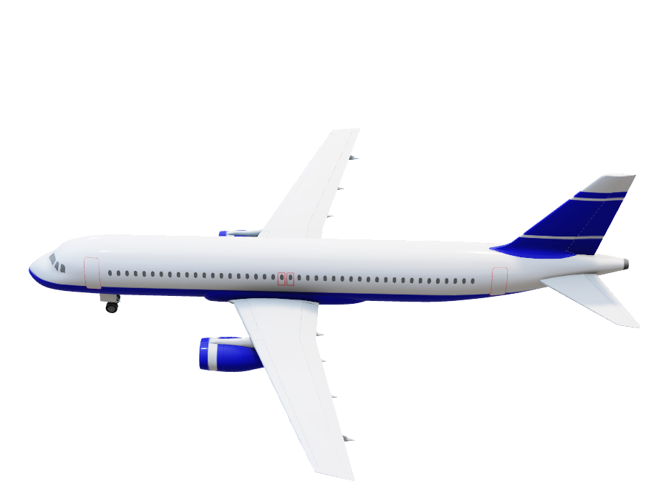
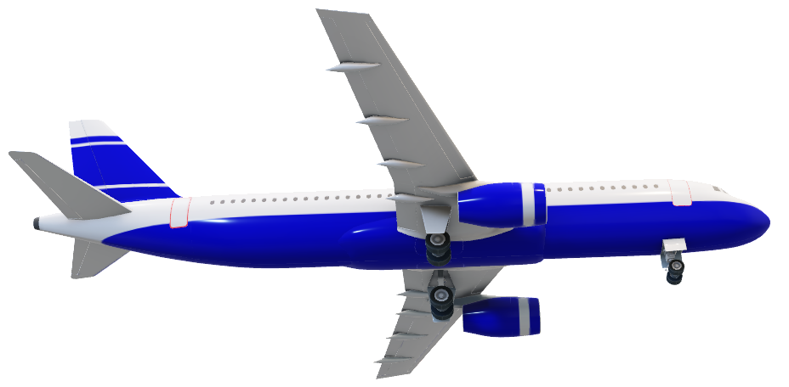
Aircraft conflict resolution
Introduction
prova
Our problem concerns resolving air conflicts, with the objective of avoiding collisions between aircraft while keeping them out of danger zones. To address this problem, a hybrid control system combining discrete and continuous control elements was implemented.

Slide 2
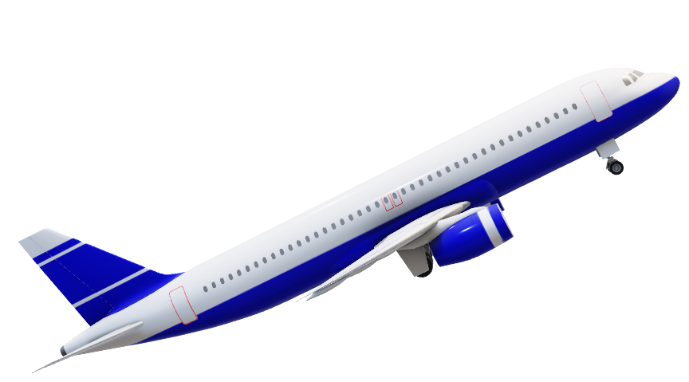

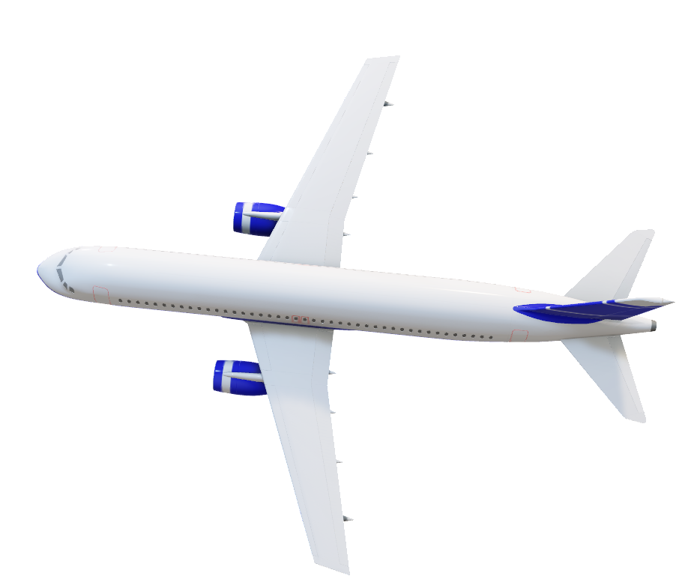
Collision avoidance airplane
Introduction
Our problem concerns resolving air conflicts, with the objective of avoiding collisions between aircrafts while keeping them out of danger zones. To address this problem, a hybrid control system combining discrete and continuous control elements was implemented.
prova

Slide 3
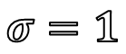
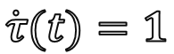
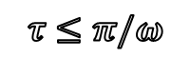
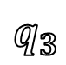
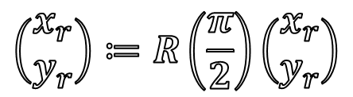
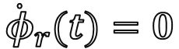
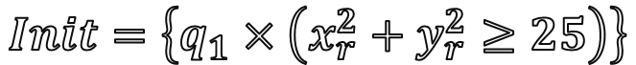
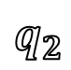
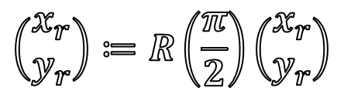
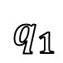
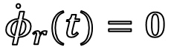
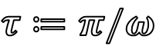
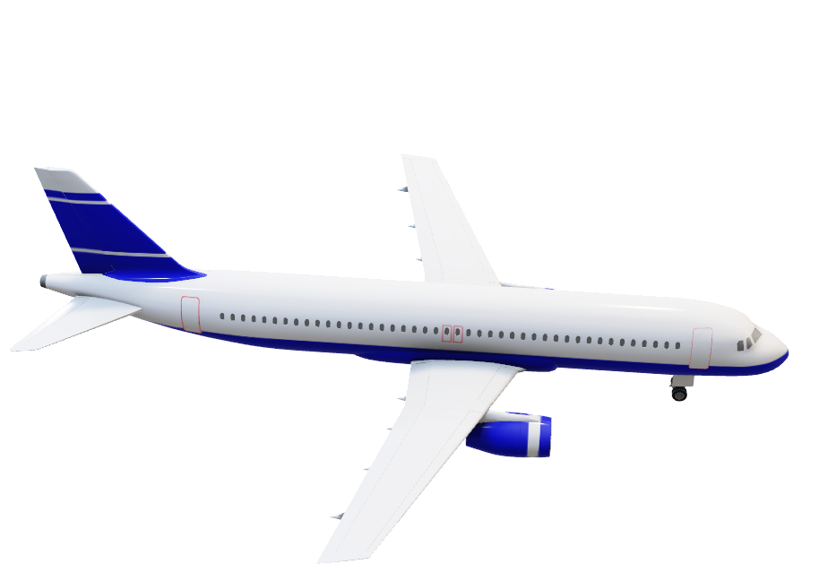
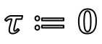
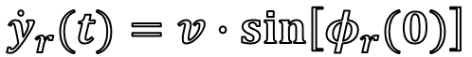
Control input event
Cruise
$$Init=\left\{q_{1}×\left(x_{r}^{2}+y_{r}^{2}≥25\right)\right\}$$
$$q_{1}$$
$$σ=1$$
$$τ≔0$$
$$\left(\begin{matrix}x_{r} \\ y_{r}\end{matrix}\right)≔R\left(\frac{π}{2}\right)\left(\begin{matrix}x_{r} \\ y_{r}\end{matrix}\right)$$
$${\dot{x}}_{r}(t)=−v+v∙\cos\left[φ_{r}(0)\right]$$
Half-circle
$${\dot{y}}_{r}(t)=v∙\sin\left[φ_{r}(0)\right]$$
$$τ≤π/ω$$
$${\dot{φ}}_{r}(t)=0$$
$$q_{2}$$
$$τ≔π/ω$$
$$\left(\begin{matrix}x_{r} \\ y_{r}\end{matrix}\right)≔R\left(\frac{π}{2}\right)\left(\begin{matrix}x_{r} \\ y_{r}\end{matrix}\right)$$
$${\dot{x}}_{r}(t)=−v+v∙\cos\left[φ_{r}\left(0\right)\right]+{ωy}_{r}(t)$$
Cruise
$${\dot{y}}_{r}(t)=v∙\sin\left[φ_{r}(0)\right]−{ωx}_{r}(t)$$
$${\dot{φ}}_{r}(t)=0$$
$$q_{3}$$
$$\dot{τ}(t)=1$$

Slide 4
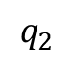
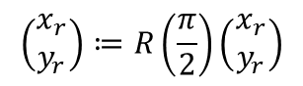
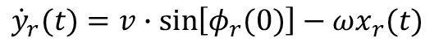
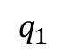
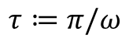
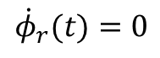
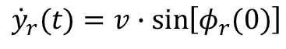
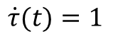
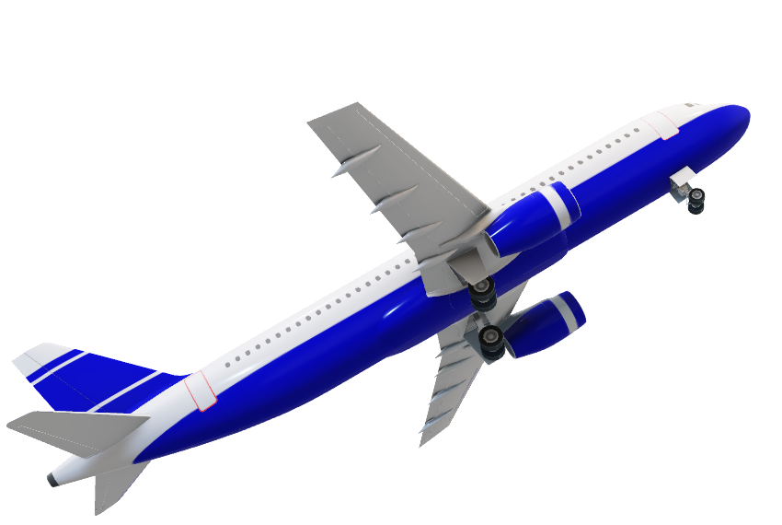
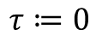
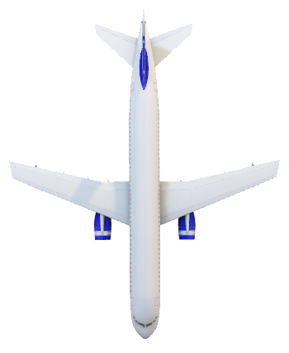
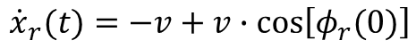
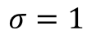
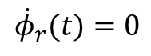

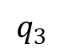
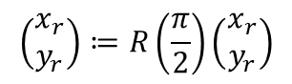

$$φ_{r}(t)=180$$
Cruise 1
$$q_{1}$$
$$σ=1$$
$$τ≔0$$
$$\left(\begin{matrix}x_{r} \\ y_{r}\end{matrix}\right)≔R\left(\frac{π}{2}\right)\left(\begin{matrix}x_{r} \\ y_{r}\end{matrix}\right)$$
$${\dot{x}}_{r}(t)=−v+v∙\cos\left[φ_{r}(0)\right]$$
$${\dot{y}}_{r}(t)=v∙\sin\left[φ_{r}(0)\right]$$
Half-circle
$${\dot{φ}}_{r}(t)=0$$
$$q_{2}$$
$$τ≔π/ω$$
$$\left(\begin{matrix}x_{r} \\ y_{r}\end{matrix}\right)≔R\left(\frac{π}{2}\right)\left(\begin{matrix}x_{r} \\ y_{r}\end{matrix}\right)$$
$${\dot{x}}_{r}(t)=−v+v∙\cos\left[φ_{r}\left(0\right)\right]+{ωy}_{r}(t)$$
$${\dot{y}}_{r}(t)=v∙\sin\left[φ_{r}(0)\right]−{ωx}_{r}(t)$$
Cruise
$${\dot{φ}}_{r}(t)=0$$
$$q_{3}$$
$$\dot{τ}(t)=1$$

Slide 5
$$φ_{r}(t)=180$$
Conflict Zone

Slide 6
$$φ_{r}(t)=180$$

Slide 7

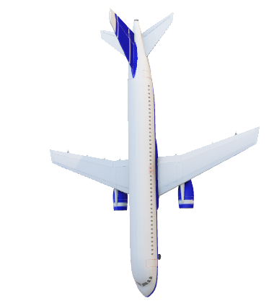
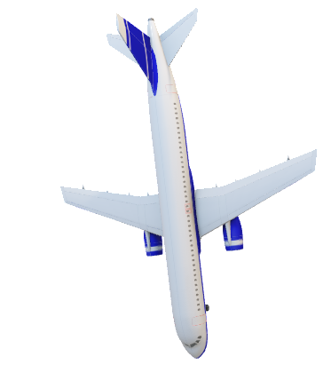
$$φ_{r}(t)=180$$

Slide 8
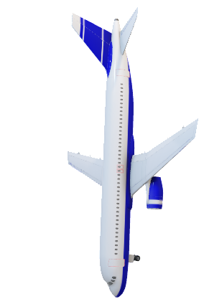
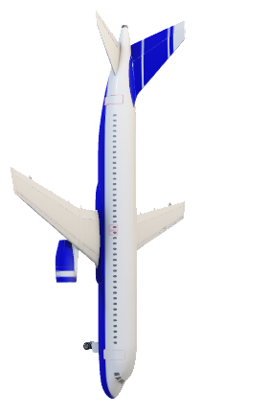
$$φ_{r}(t)=180$$

Slide 9
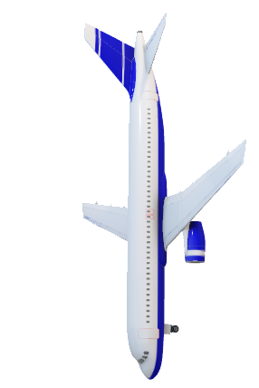
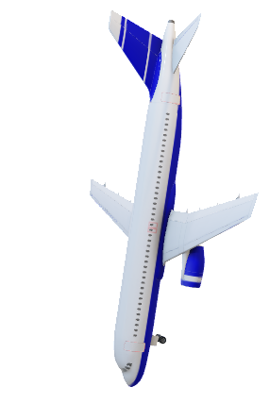
$$φ_{r}(t)=180$$

Slide 10
$$φ_{r}(t)=180$$

Slide 11
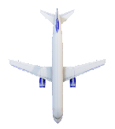
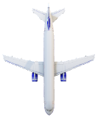

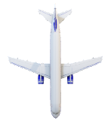
4
3
1
i

Slide 12
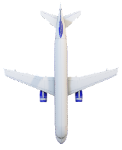
4
3
1
i

Slide 13
4
3
1
i

Slide 14
4
3
1
i

Slide 15
4
3
1
i

Slide 16
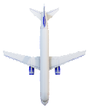

Slide 21
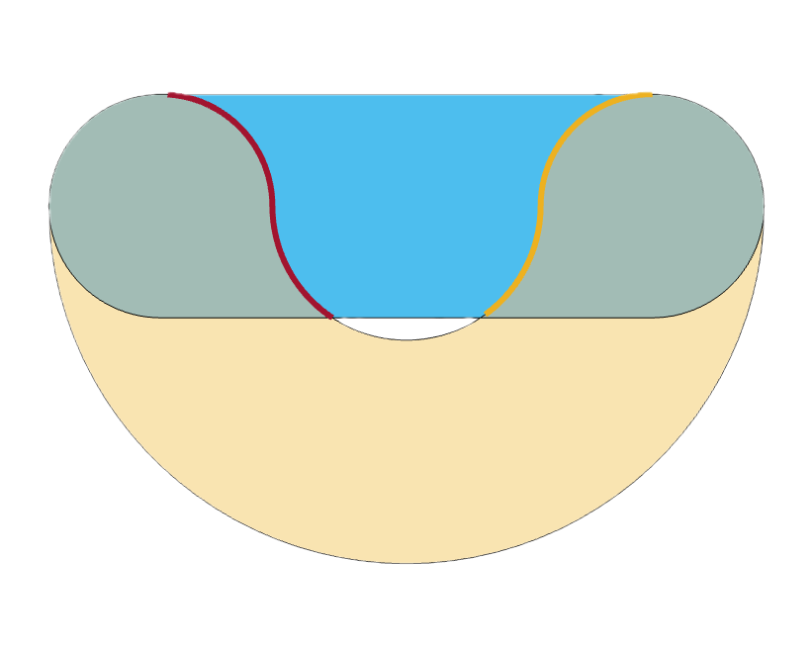

Safe Manouver Zone
$σ$forced zone
Unsafe zone
Unsafe zone

Slide 22
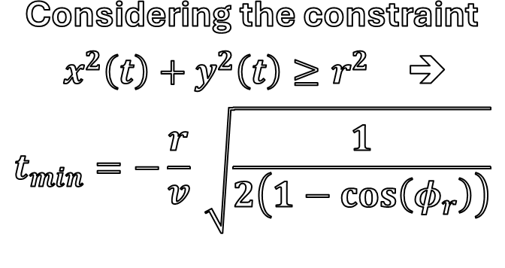
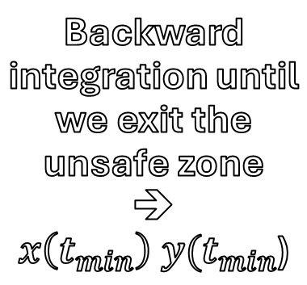
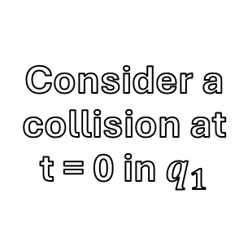

$R_{min}$ calculation
$t_{min}$ calculation
Backward integration until we exit the unsafe zone ➔ $x\left(t_{min}\right) y(t_{min}$)
Considering the constraint
$x^{2}\left(t\right)+y^{2}\left(t\right)≥r^{2}$ ➔
$$t_{min}=−\frac{r}{v} \sqrt{\frac{1}{2\left(1−cos\left(φ_{r}\right)\right)}}$$
Consider a collision at t = 0 in $q_{1}$
$t_{min}$:

Slide 23




$t_{min}$ calculation
$R_{min}$ calculation
Backward integration until we exit the unsafe zone ➔
$$x\left(t_{0}\right) \\ y(t_{0})$$
Consider a collision at t = 0 in $q_{1}$
Forward integration in $q_{2}$ to avoid the collision
Radius
Relation:
Considering the constraint
$x^{2}\left(t\right)+y^{2}\left(t\right)≥r^{2}$ ➔
$${\left(4R−vt_{0}\right)}^{2}≥\frac{r^{2}}{2(1−cos\left(φ_{r}\right))}$$

